Slide 1
Data-Driven Fairness Analysis of NYC MTA Transit Fares
FINAL PRESENTATION
PRESENTED BY:
Kamili Afra (ak12151@nyu.edu) Kunjal Bhatta (kb4850@nyu.edu) Yaqi Guo (yg3481@nyu.edu) Yuqi Wen (yw8416@nyu.edu)
MAY 2nd 2025

Slide 2
INTRODUCTION & GOALS
Trespassing are still common problem that’s daily seen on MTA subways, indicates there might be a burden issue on paying the subway
Public transit is the backbone of urban mobility in New York City, yet fare structures can unintentionally place a heavier financial burden on low-income and marginalized communities
MTA has tried to give equal access by having different cap of fare type options for different group of people (Metrocard Full-Fare, Metrocard Fair-Fare, OMNY Full-Fare, etc.)
Our goals:
Identify which demographic and geographic factors are most associated with fare burden
Understand how different type fare policies affect the fare burden

Slide 3




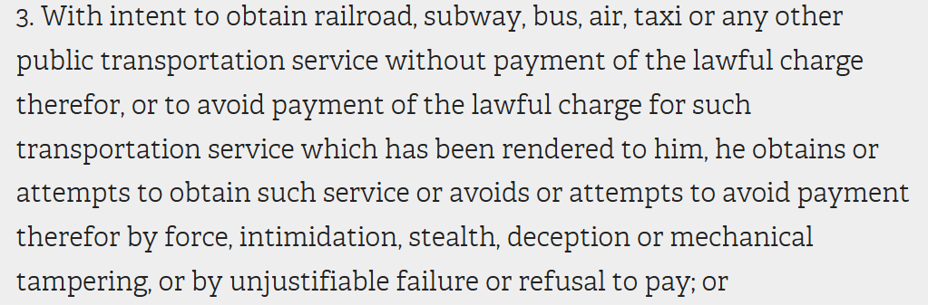
DATA SOURCES
MTA Ridership & Fare-Type Records
Monthly station-level counts by fare media
OMNY Usage Data
Tap-in counts for full-fare and reduced-fare customers
American Community Survey (ACS)
5-Year Estimates of tract-level median household income & demographic breakdowns
The New York State Senate
NYPD Arrests Data (Historic)

Slide 4
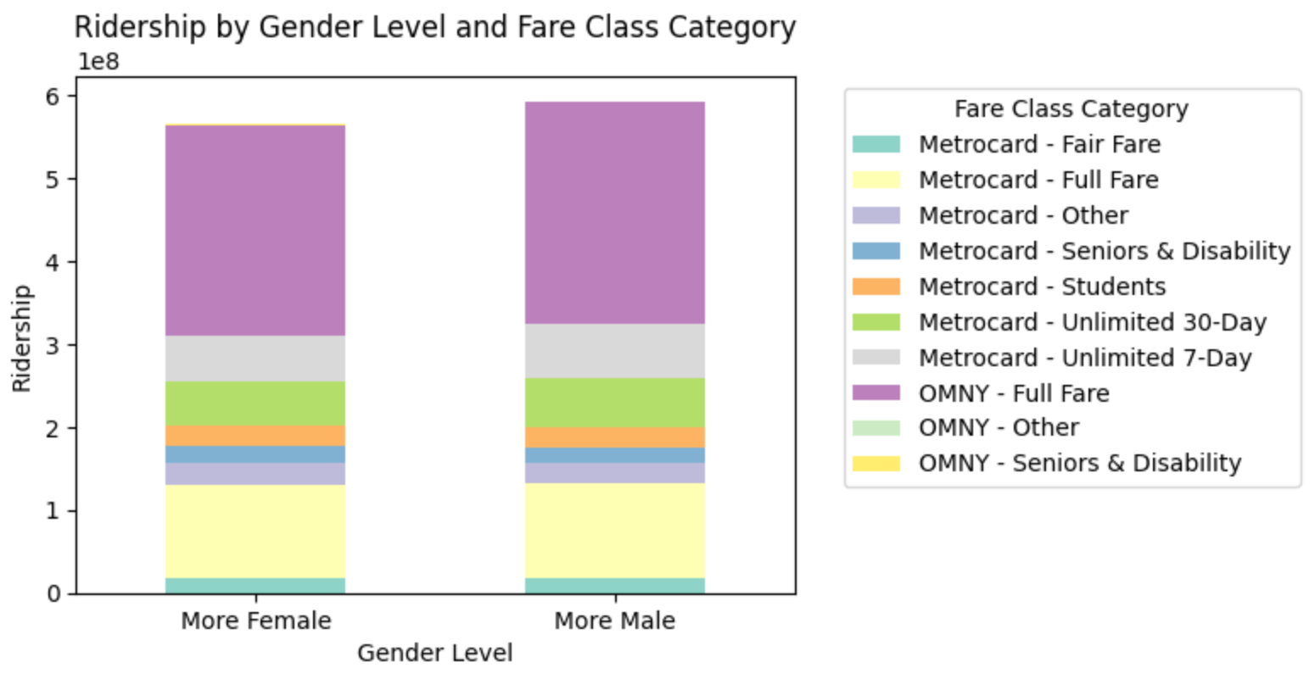
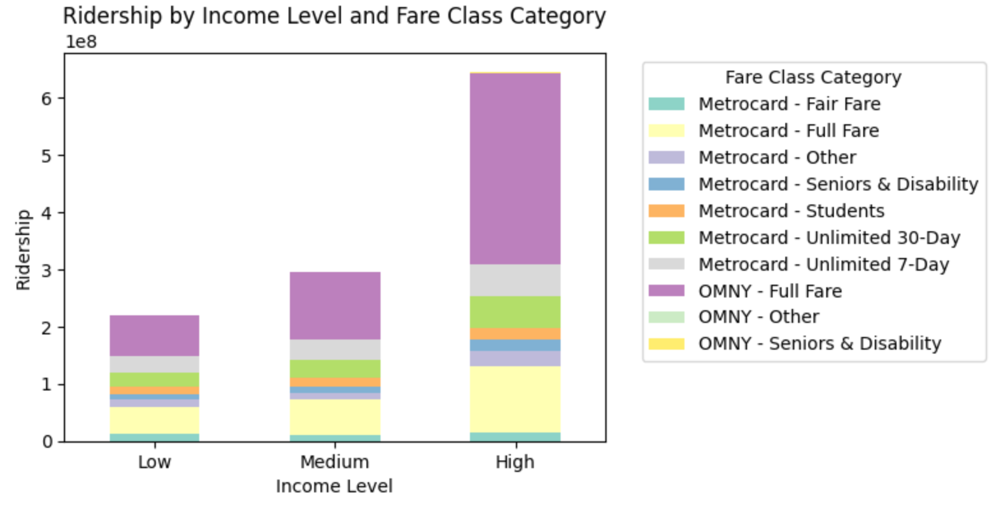
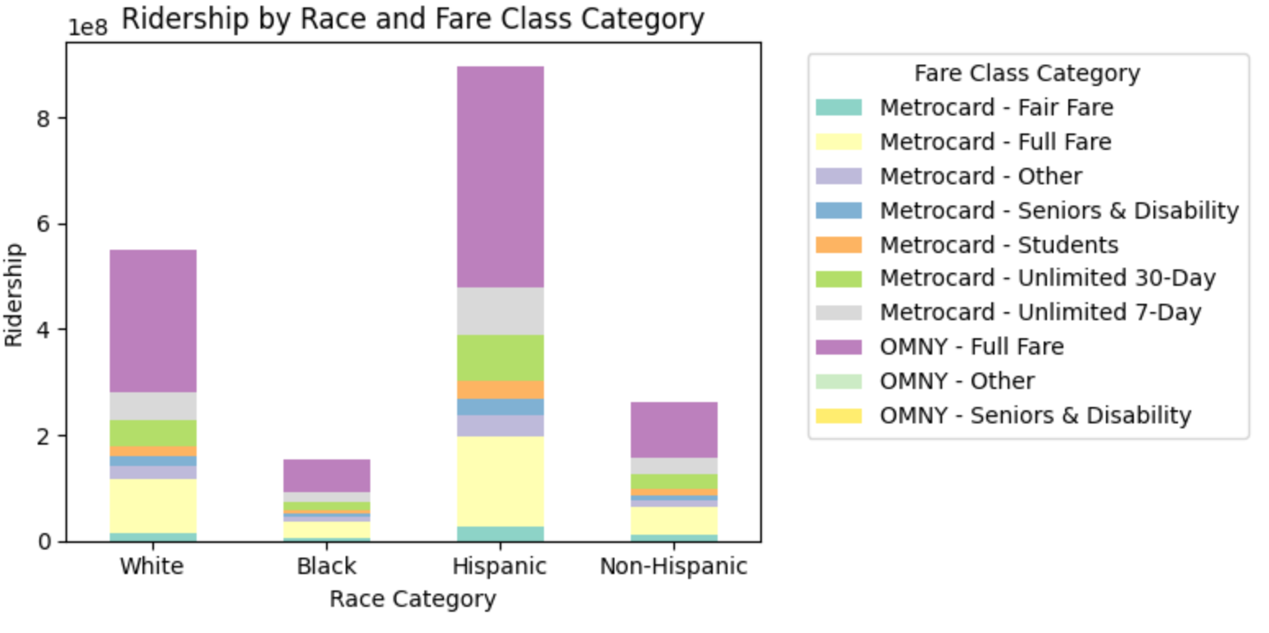
DATA ANALYSIS
Fare Class Category selection shows significant variation across race and income levels
The proportion of Full Fare tickets is notably higher in high-income populations, as it shows in Hispanic group

Slide 5
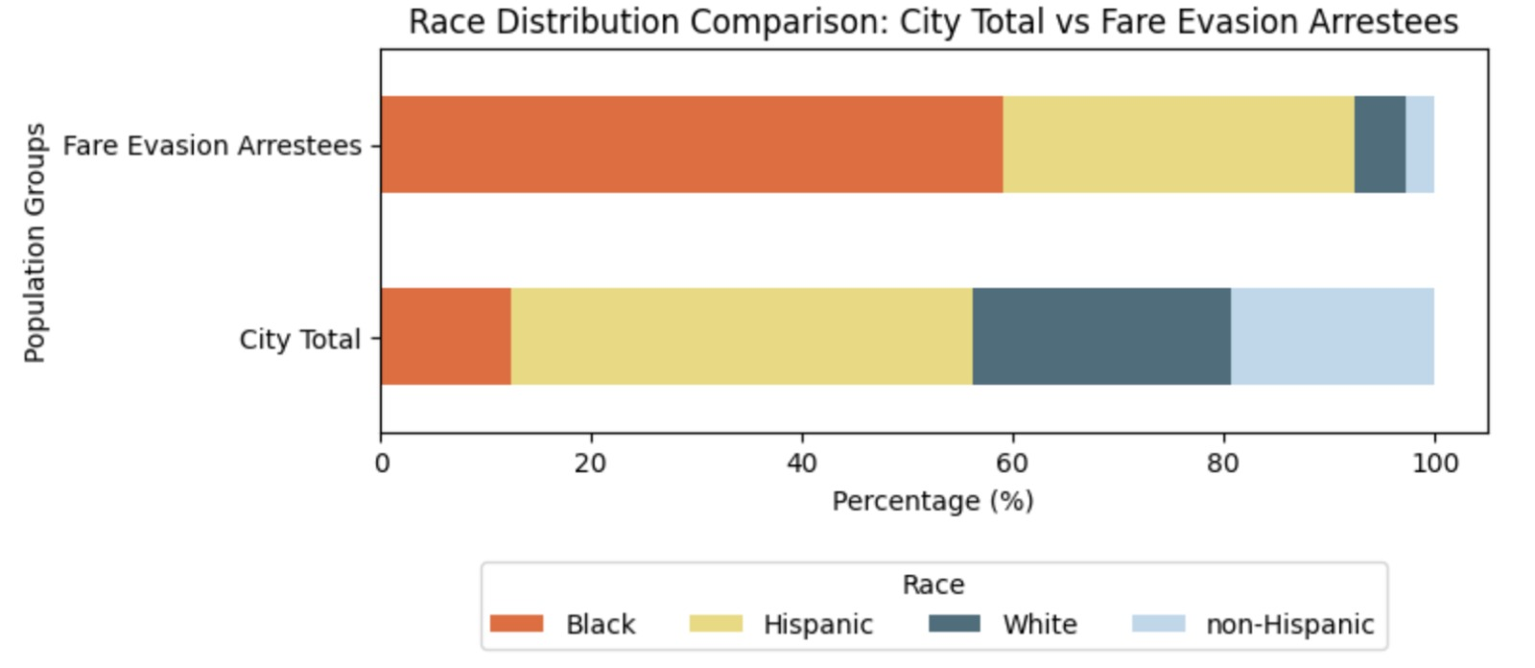
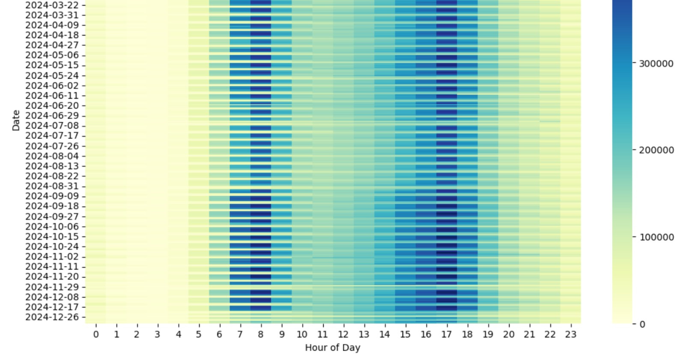
DATA ANALYSIS
6:00 am ~ 10:00 am
What is the metric of FARE BURDEN?
 | Outcome rates | Ratio
Black | 0.000399 | 34.7
White | 0.0000169 | 1.47
Hispanic | 0.000064 | 5.57
Non-Hispanic | 0.0000115 | 1
Hourly Ridership Trends Across Dates (2023)

Slide 6
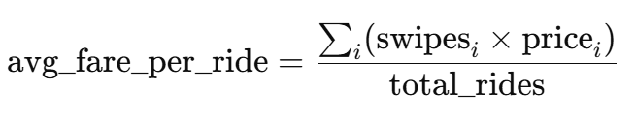
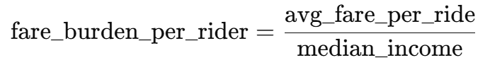
KEY VARIABLES
1. Average Fare per Ride (avg_fare_per_ride)
Weighted average fare based on the number of swipes for each fare type i:
where i refers to different fare types (e.g., regular, senior, student).
2. Fare Burden per Rider (fare_burden_per_rider)

Slide 7
METHODS
Disparity Matrix (Demographic Parity and Disparate Impact)
Identify how the fare burden is distributed across different demographic groups.
Decision Tree and Random Forest
Analyze whether specific demographic or fare type characteristics influence the likelihood of experiencing high fare burden.
T-test + Bayesian Network Modeling:
Explore potential causal relationships among fare burden, income level, and demographic composition.
Anomaly Detection (Isolation Forest + Local Outlier Factor)
Identify areas with abnormal fare burden based on demographic characteristics
Causal Inference – Average Treatment Effect (ATE)
Assess whether demographic changes significantly affect average fares.

Slide 8
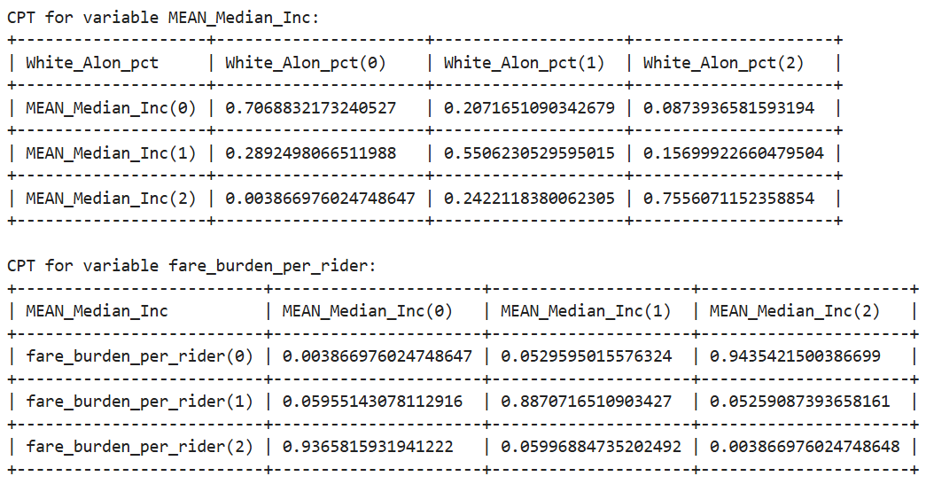
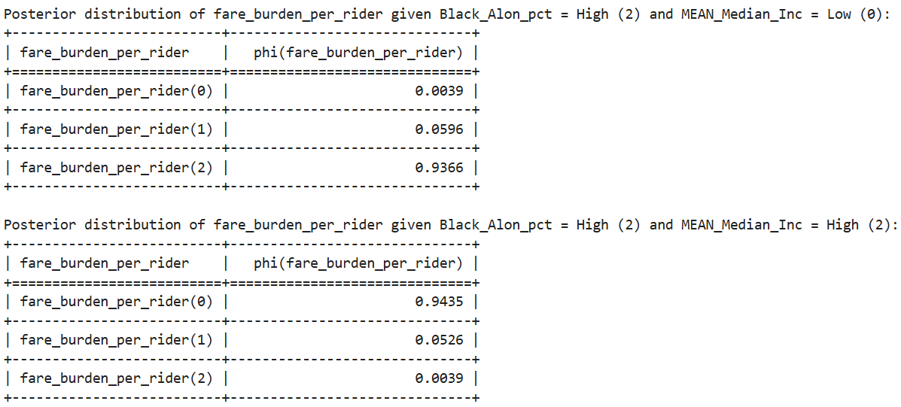
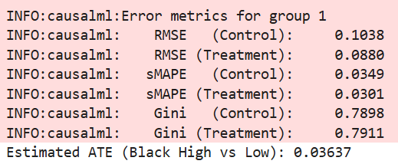
RESULTS
Higher Black population ➡️ Lower income ➡️ Greater fare burden
Higher White population ➡️ Higher income ➡️ Lower fare burden
Economic and structural drivers make it difficult to isolate the direct effect of race on fare burden.
Causal Inference
After controlling for income and demographics, areas with higher Black populations pay $0.036 more per ride on average.

Slide 9
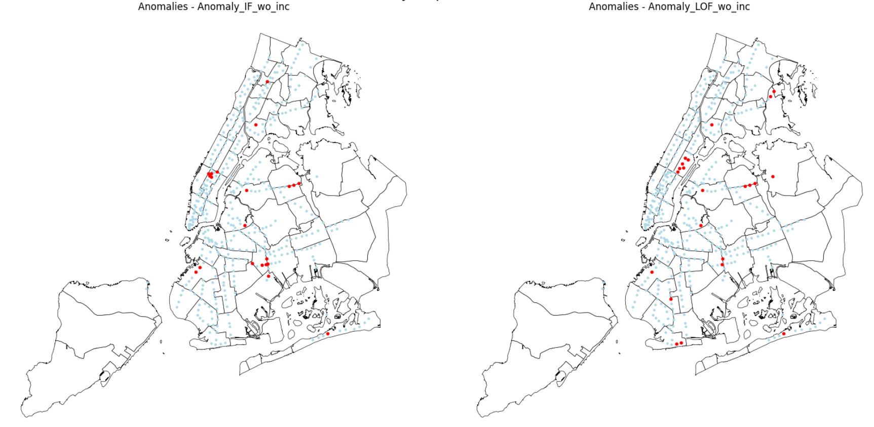
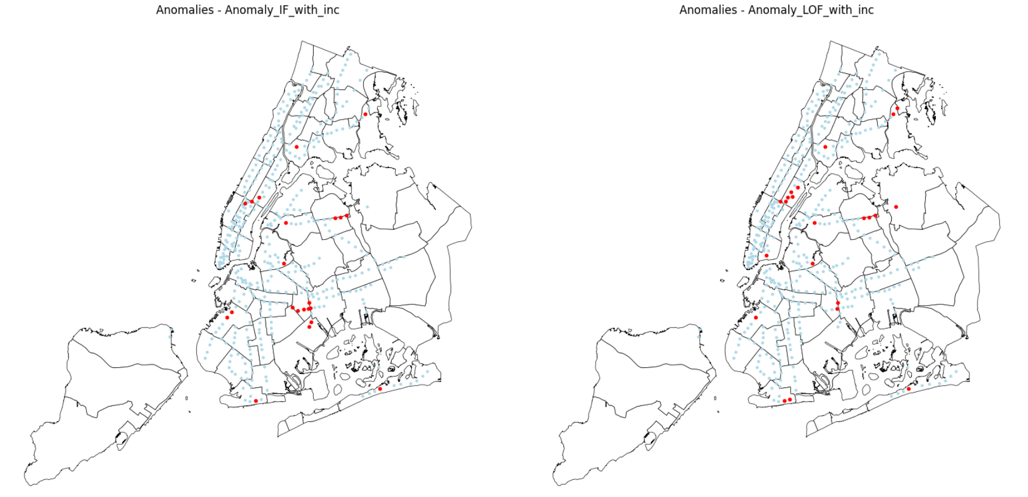
Outliers with High Fare Burdens
Model | Inliers | Outliers
With income - IF | 0.000031 | 0.000042
With income - LOF | 0.000031 | 0.000041
Without income - IF | 0.000031 | 0.000040
Without income - LOF | 0.000031 | 0.000040

Slide 10
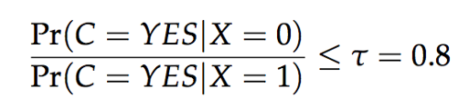
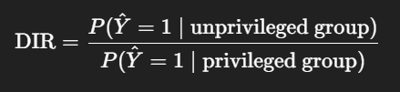
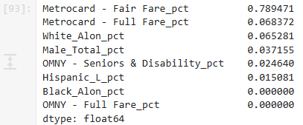
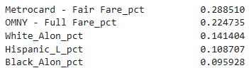
RESULTS
Decision Tree (AUC score: 78.4%)
Feature Importance
Disparity Matrix between Different Groups
 | Demographic Parity | Disparate Impact Ratio
Group by Color
Black | 0.4 | 1
White | 0.4
Group by Gender
Male | 0.44 | 0.87
Female | 0.5
Group by Economic Status
High Income | 0.43 | 0.8
Low Income | 0.54
Group by Race
Hispanic | 0.44 | 0.64
Non-Hispanic | 0.69
Random Forest (AUC score: 90%)
Feature Importance

Slide 11
CONCLUSION
LIMITATION
Non-Hispanic and lower-income groups tend to experience a higher fare burden.
There is no significant difference in fare burden across gender and skin-color groups.
The MetroCard Fair Fare payment type is the most significant factor associated with fare burden.
Spatial Assumptions: station demographic status are based on station serving area (tracts within 0.3 mile walking distance)
We assume local riders are those who enter the station between 6 am-10 am.
Income Estimates: ACS 5-year median household incomes are multi-year averages, potentially masking recent economic shifts at the tract level.
Fairness Metrics: Demographic parity and disparate-impact ratios quantify equity gaps but cannot fully account for historical disinvestment or service quality differentials across neighborhoods.
Causal Inference: Our Bayesian network suggests associations among variables, but without experimental or longitudinal data, true causality cannot be definitively established.
Notes:
Non Hispanic group of people tend to have a higher burden

Slide 12
REFERENCES
Rothbacher, N. S. (2020). Discrimination, fairness and prediction in policing: fare evasion in New York City (Doctoral dissertation, Massachusetts Institute of Technology).
Blumenberg, E., & Pierce, G. (2014). A driving factor in mobility? Transportation’s role in connecting subsidized housing and employment outcomes in the Moving to Opportunity (MTO) program. Journal of the American Planning Association, 80(1), 52–66. https://doi.org/10.1080/01944363.2014.935267
Brown, A. E. (2018). Fair fares? How flat and variable fares affect transit equity in Los Angeles. Case Studies on Transport Policy, 6(4), 765–773. https://doi.org/10.1016/j.cstp.2018.09.011
Perrotta, A. F. (2017). Transit fare affordability: Findings from a qualitative study. Public Works Management & Policy, 22(3), 226–252. https://doi.org/10.1177/1087724X16650201
Watts, A. G. (2023). Overcoming cost barriers to public transit access: A policy analysis [Technical report]. University of Pittsburgh, School of Social Work. https://doi.org/10.13140/RG.2.2.21439.01448

Slide 13
Ensuring transit affordability is fundamental to advancing equity and social inclusion in urban environments.

Slide 14
TASK: Causal Inference, Fairness Assessment
RQ: Do certain groups pay a higher proportion of their income?
Independent
variables
Machine learning methods
Derived
variable
Fairness measure
Census: income, age
(tracts)
Bayesian Network
aggregate fare burden
Demographic Parity
or
Disparate Impact
Geopandas join
Learn causal relationships among variables
Subway Ridership
(6-10am, buffer)

